Slide 1

Credit Card Approval Prediction Group 4
Presented By-
Ankita Sharma
Avinash Reddy Kondeti
Nagababu Veganti
Yeshwanth Soma

Slide 2
Introduction
In the recent years Statistics show that there has been an increase in number of people applying for credit card, In the 20th century where data is playing vital role in every business, we are trying to use this data to make this process more streamline.
Through this project, we are trying to build predictive models that can predict if a person gets his/her credit card approved based on their application data and previous credit history over time.

Slide 3
Data Flow
.
Feature Selection
Data Splitting
Feature Extraction
Model Training
Model Evaluation on Test Data
Data Preprocessing
Data
Exploratory Analysis

Slide 4
Dataset Review
Data sourced from Kaggle
https://www.kaggle.com/rikdifos/credit-card-approval-prediction
Data Set Attributes:
Application Record: This file had data related to all the Credit Card applicants and each applicant had 17 attributes. Some of the attributes used in the analysis are Age(Continuous), Count of family members(Discrete), average income(Continuous), occupation(Categorical), gender(Categorical).
Credit Record: Credit Information related to each applicant such as Number of missed payment, Number of loans, Number of intime payments.
The dataset has information about 438,558 candidates applying for Credit Cards.

Slide 5
Data Cleaning
There were some cell with missing values in the dataset for example, there were some missing values for occupation attribute which was replaced by not known. Also, for Variable Income we replaced the missing values with mean value of the column.
The age column was computed from an attribute called days_birth by dividing the days by 365 to convert it to age
The two data file was joined to create a main data file
The attribute values has been converted into multiple categorical attributes and re-joined with the original data set
Feature selection was performed as part of modelling process in different models to see improvements in evaluation parameter based on the cleaned data.

Slide 6
Assumptions
We had to make couple of assumptions on the dataset before we started of with building models.
We are given unlabeled dataset where we are only given a credit information about the person(i.e., number of payments due , number of in time payments, number of loans and overdues) based on this data we have to generate labels.
To generate the labels, we referred the various banks and other articles sites to determine number of overdue payments that can affect the persons credit score.

Slide 7
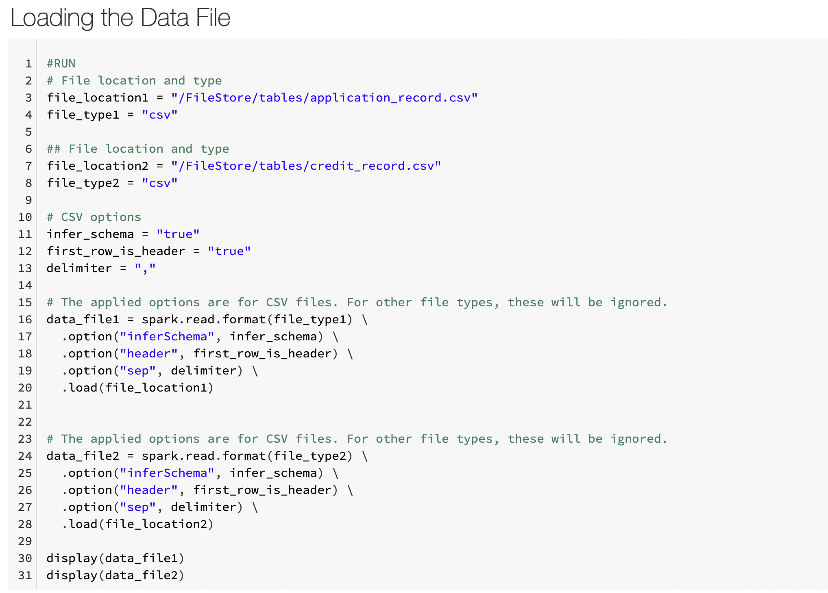
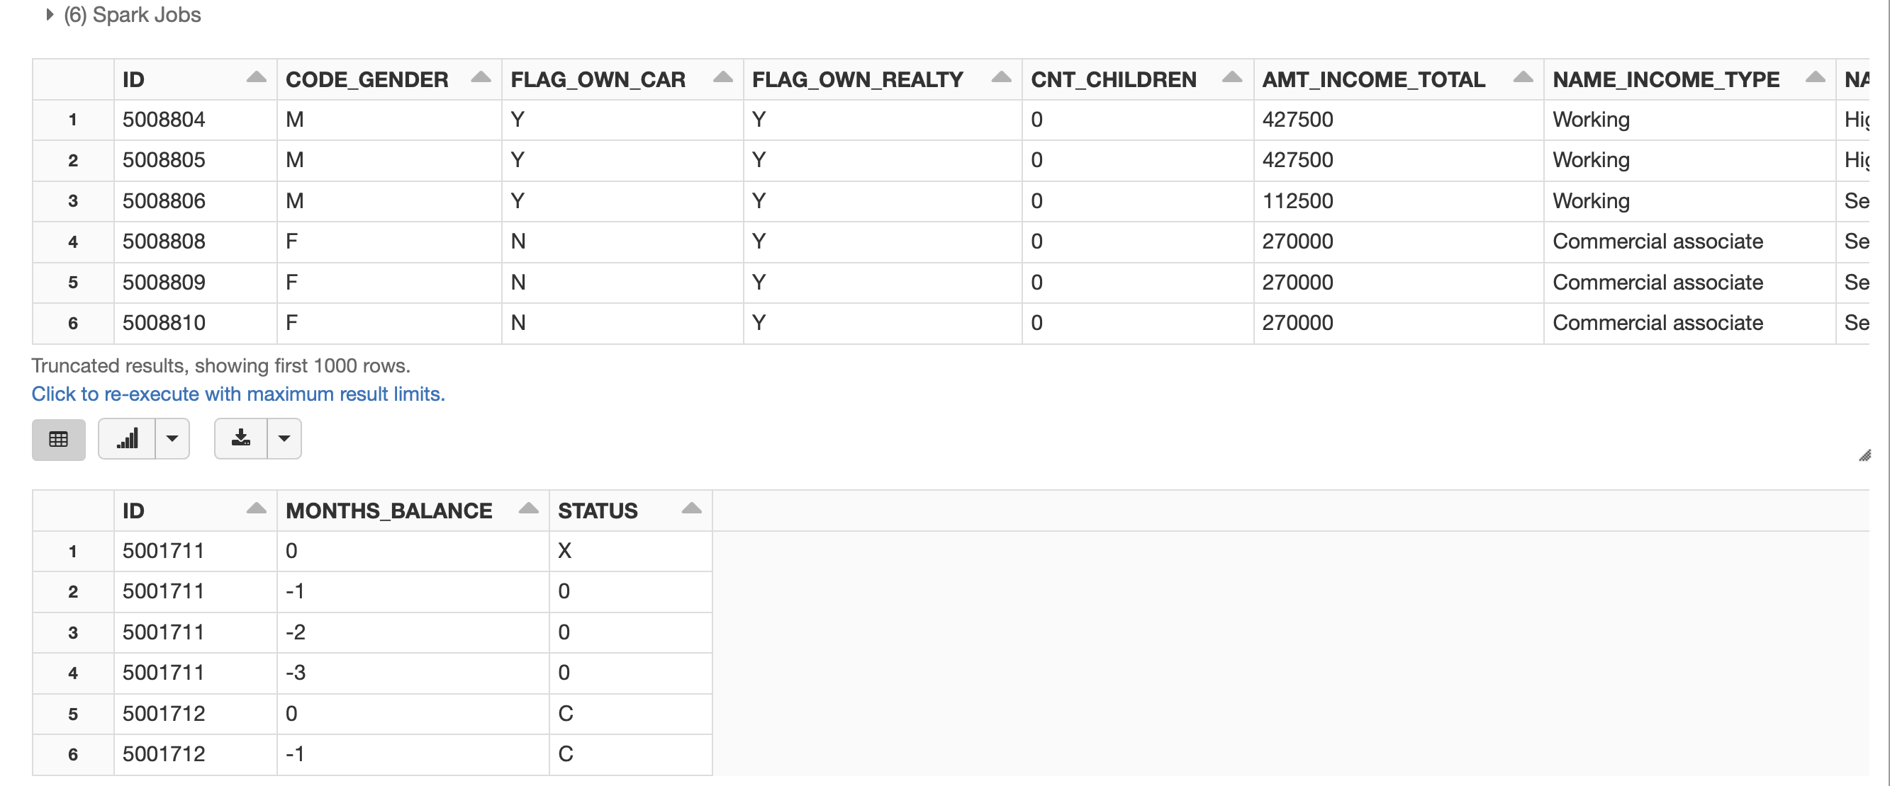
Data Overview

Slide 8
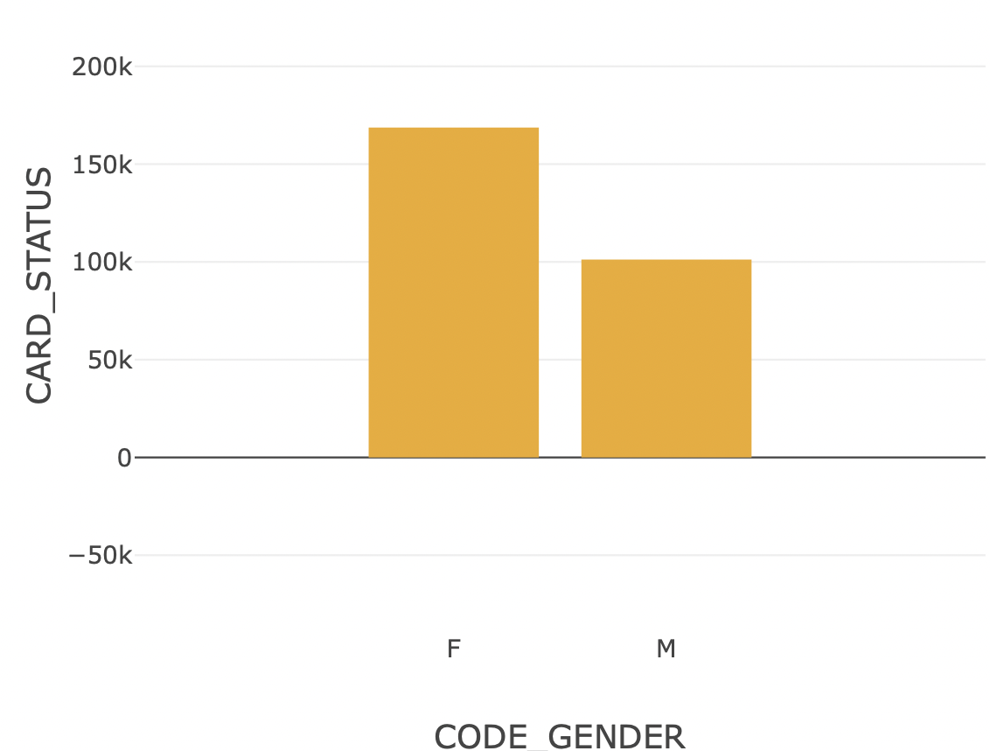
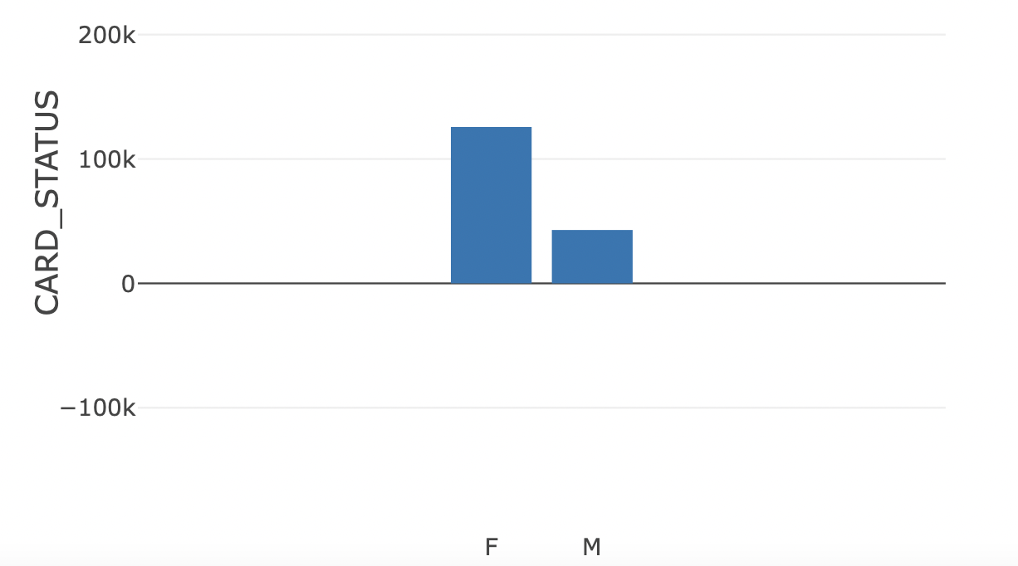
Exploratory Data Analysis on Processed Dataset.
Distribution of Card Status Accepted
Distribution of Card Status Declined

Slide 9
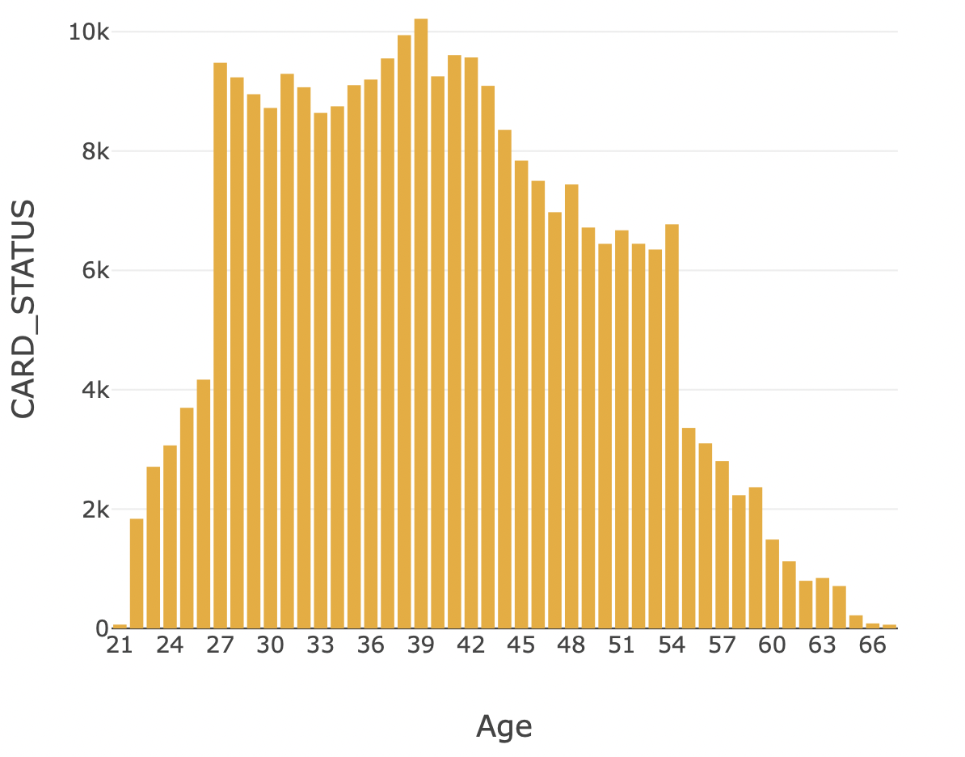
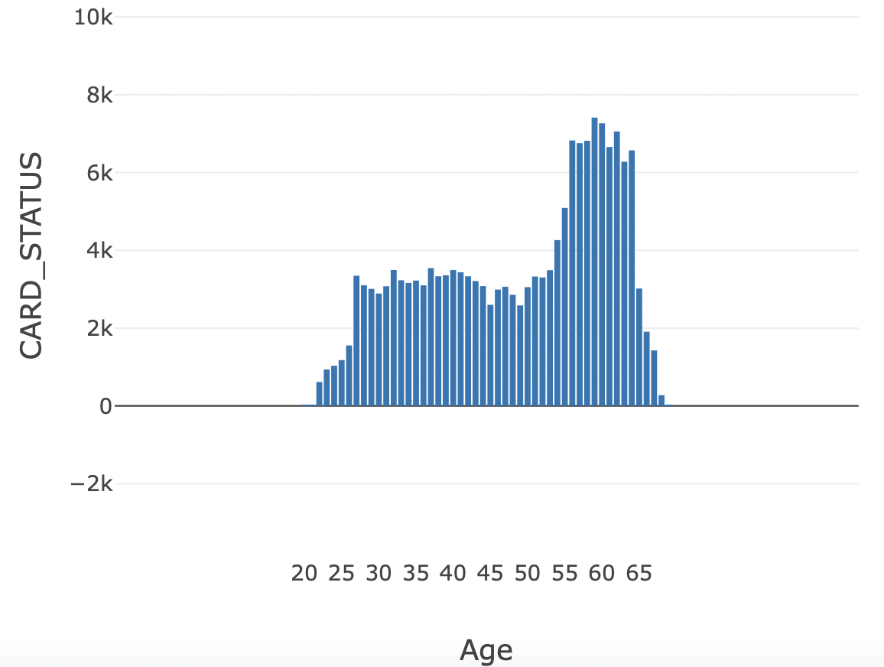
Exploratory Data Analysis on Processed Dataset.
Age Distribution CARD STATUS Accepted
Age Distribution CARD STATUS Rejected

Slide 10
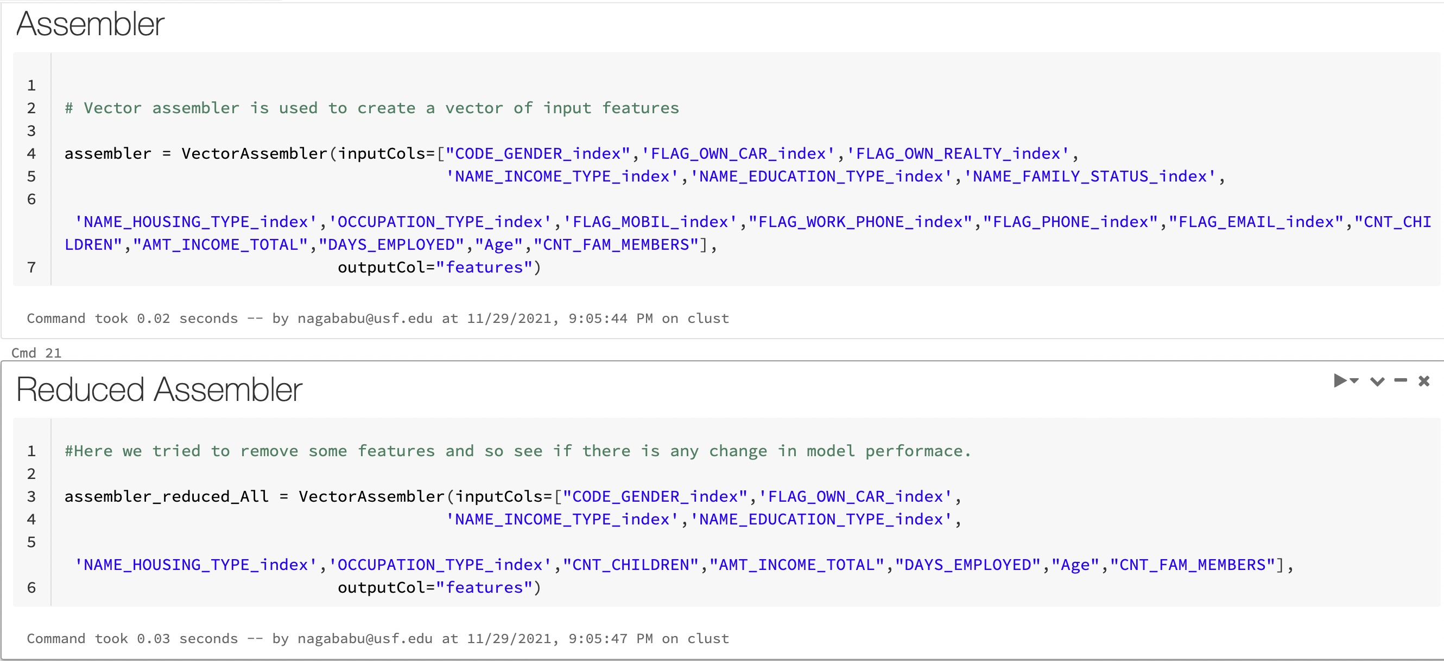
Feature Selection
We have constructed 2 Assemblers each assembler as different features that will be passed to model.
The reason we added two assemblers is to validate if there is any significant impact on model performance by reducing the features.

Slide 11

Models Implemented
Random forest
Multilayer Perceptron Classifier
Gradient-Boosted Tree Regression
Logistic Regression
Linear Support Vector Classifier

Slide 12
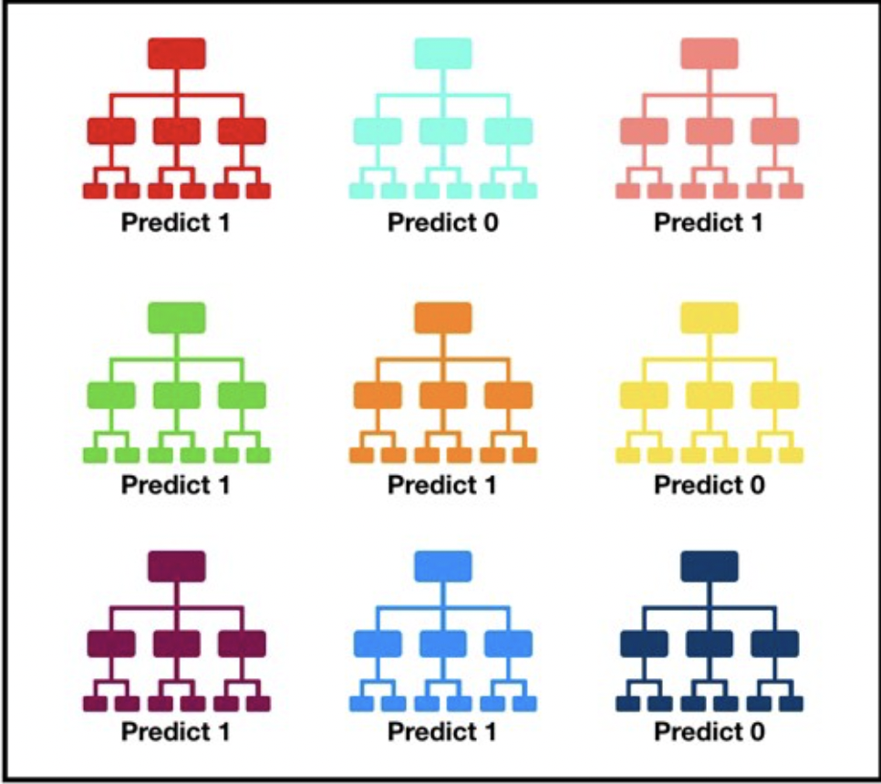
Random forest Algorithm
Random forest is a supervised machine learning algorithm that is constructed from decision tree algorithm
It utilizes ensemble learning that is a technique that combines many classifiers to provide solution to complex problem
This algorithm establishes the outcome based on the prediction of the decision trees. It predicts by taking the mean of the output of various trees.

Slide 13
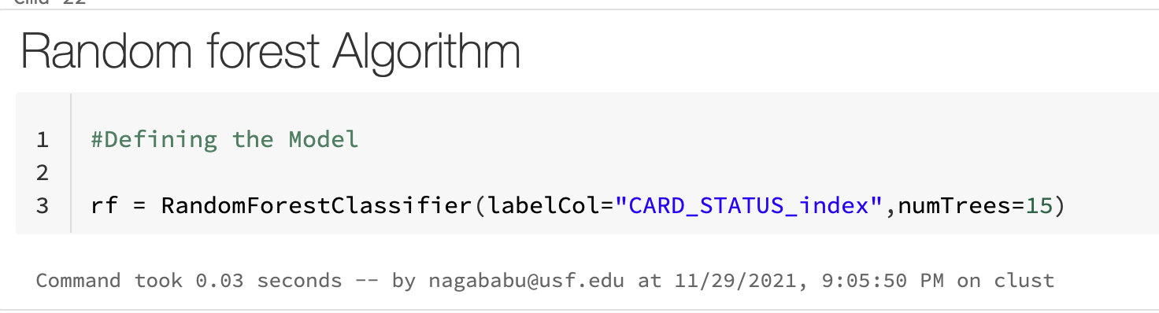
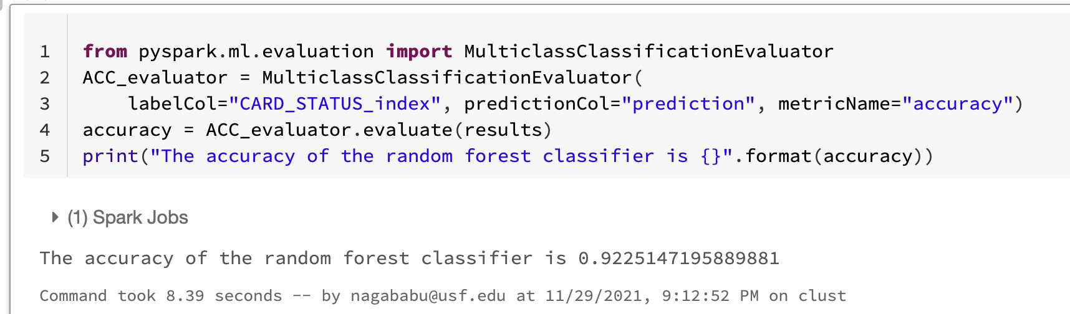
Random forest Algorithm Code:
Model Performance :
We achieved an accuracy of 92.2%.

Slide 14
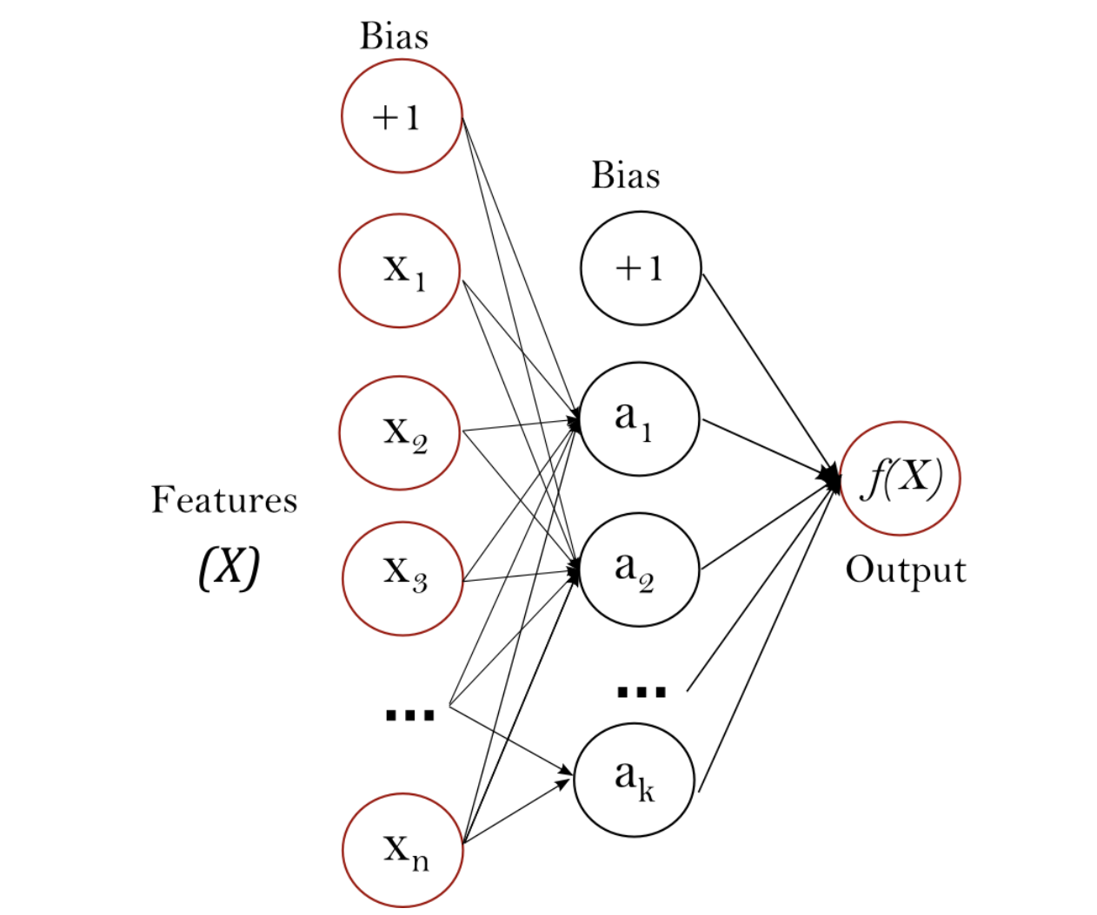
Multilayer Perceptron Classifier
It is a neural network where the mapping between inputs and output is non-linear.
Multilayer Perceptron falls under the category of feedforward algorithms, because inputs are combined with the initial weights and bias in a weighted sum and subjected to the activation function, just like in the Perceptron. But the difference is that each linear combination is propagated to the next layer.
Backpropagation is the learning mechanism that allows the Multilayer Perceptron to iteratively adjust the weights in the network, with the goal of minimizing the cost function.

Slide 15
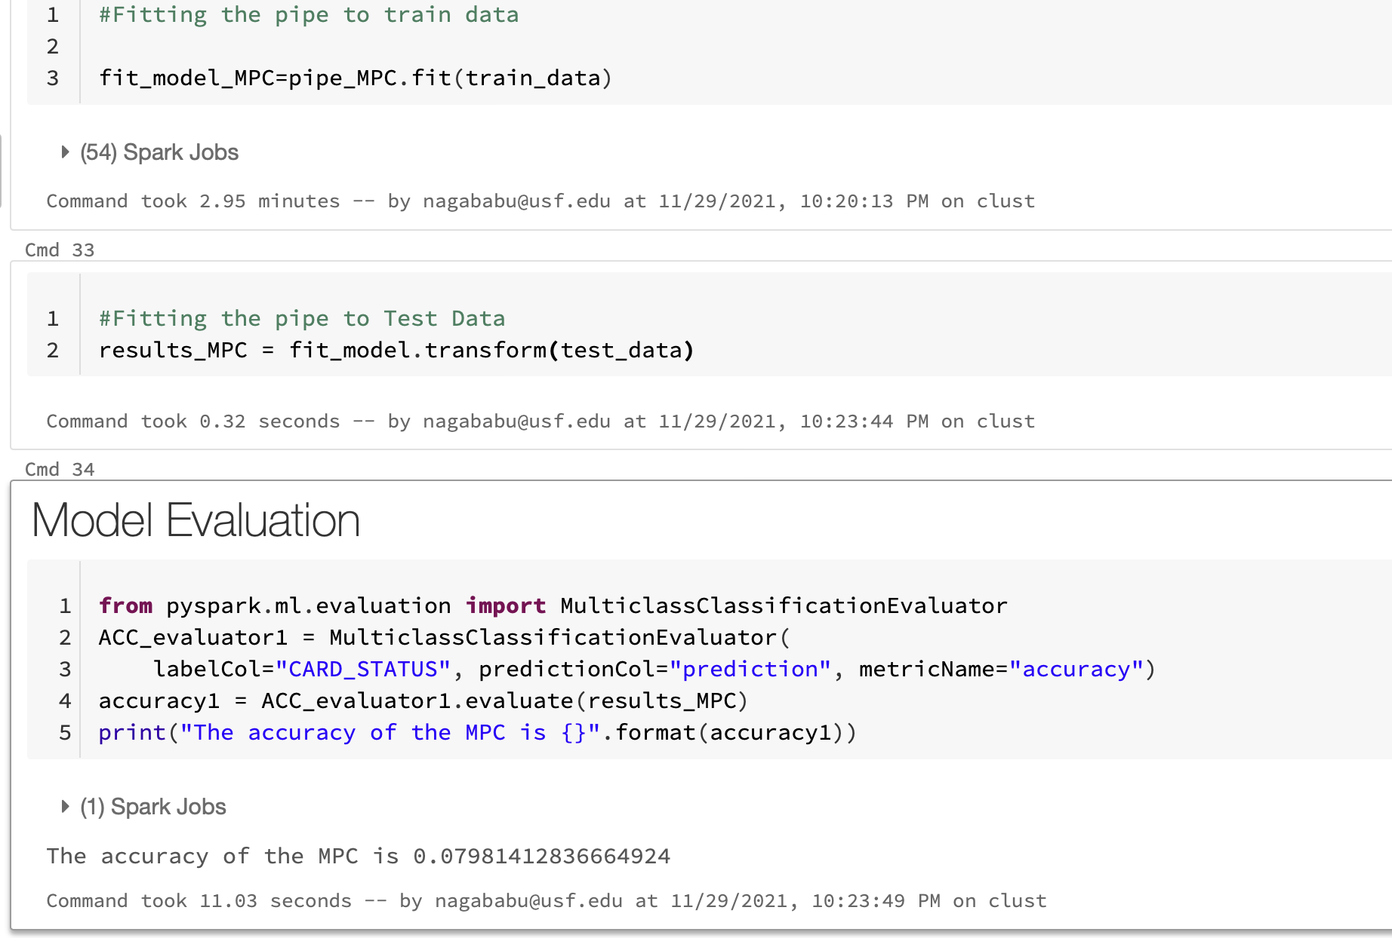
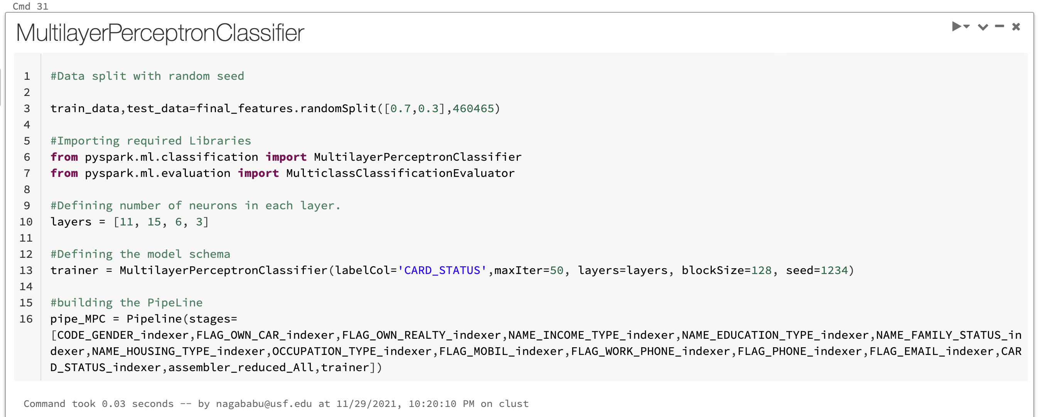
Multilayer Perceptron Classifier
We achieved model accuracy of 80%.
We believe the reason for this drop in accuracy is due to model overfitting, neural network generally tend to learn high dimensional non liner surfaces on the data, but since it is a binary class classification, model is not able find true patterns.

Slide 16
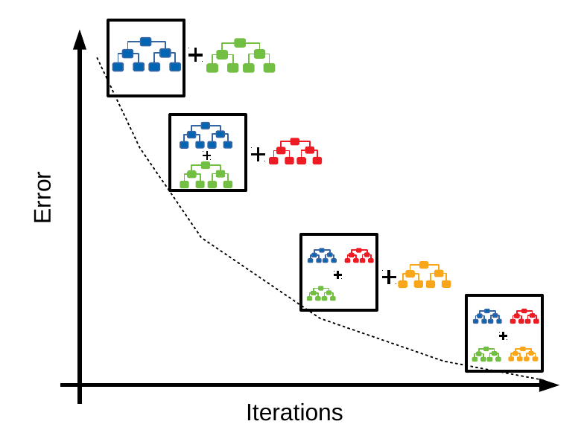
Gradient-Boosted Tree Regression
Gradient boosting involves three elements:
A loss function to be optimized.
A weak learner to make predictions.
An additive model to add weak learners to minimize the loss function.
Loss Function:
The loss function used depends on the type of problem being solved.
Weak Learner:
Decision trees are used as the weak learner in gradient boosting.
Additive Model:
Trees are added one at a time, and existing trees in the model are not changed.
A gradient descent procedure is used to minimize the loss when adding trees.

Slide 17
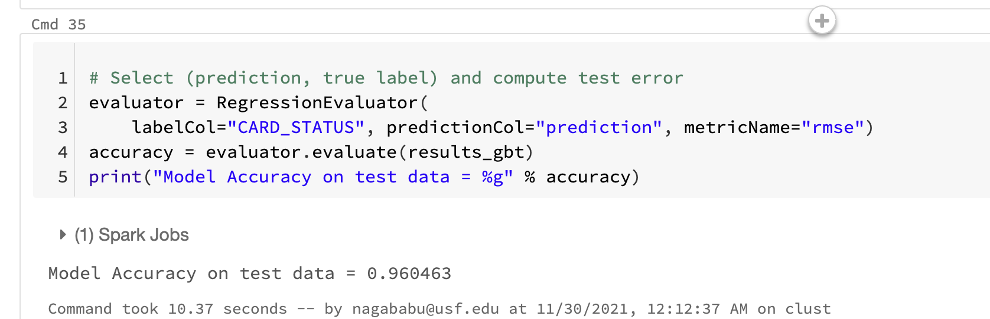
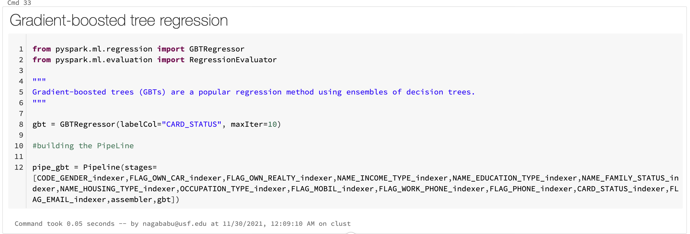
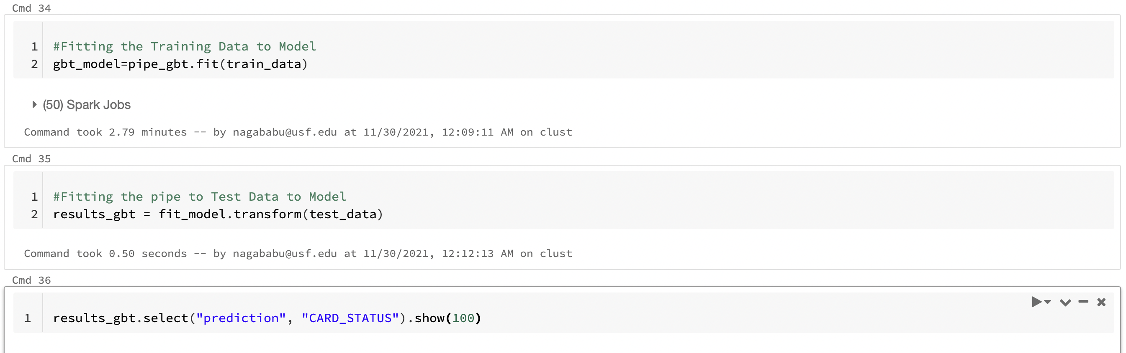
Gradient-Boosted Tree Regression Code:
Model Performance :
We achieved model accuracy of 96%.

Slide 18
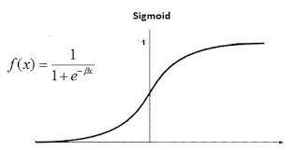
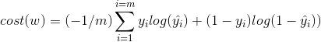
Logistic Regression
Logistic regression is a statistical method for predicting binary classes. For example, it can be used for cancer detection problems. It computes the probability of an event occurrence.
Math behind the scenes:
Sigmoid Function
Cost Function
The loss function is also called cross entropy loss, or it is also called log loss

Slide 19
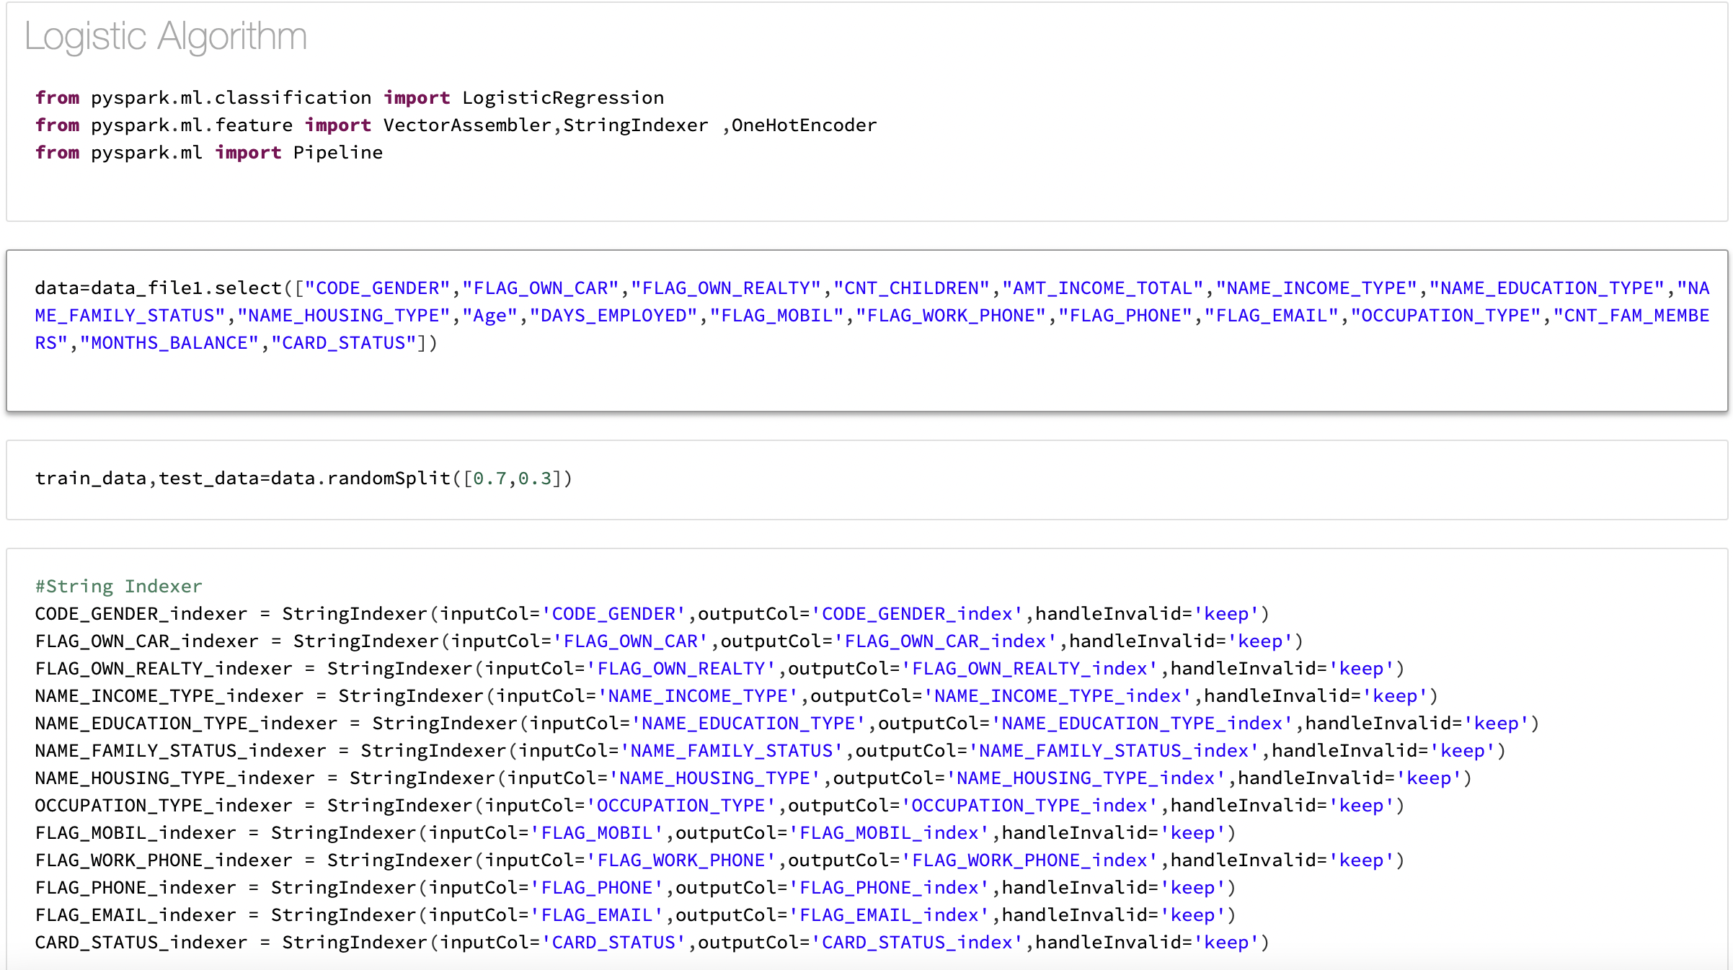
Logistic Regression Code
With Logistic Regression we achieved an accuracy of 92%

Slide 20
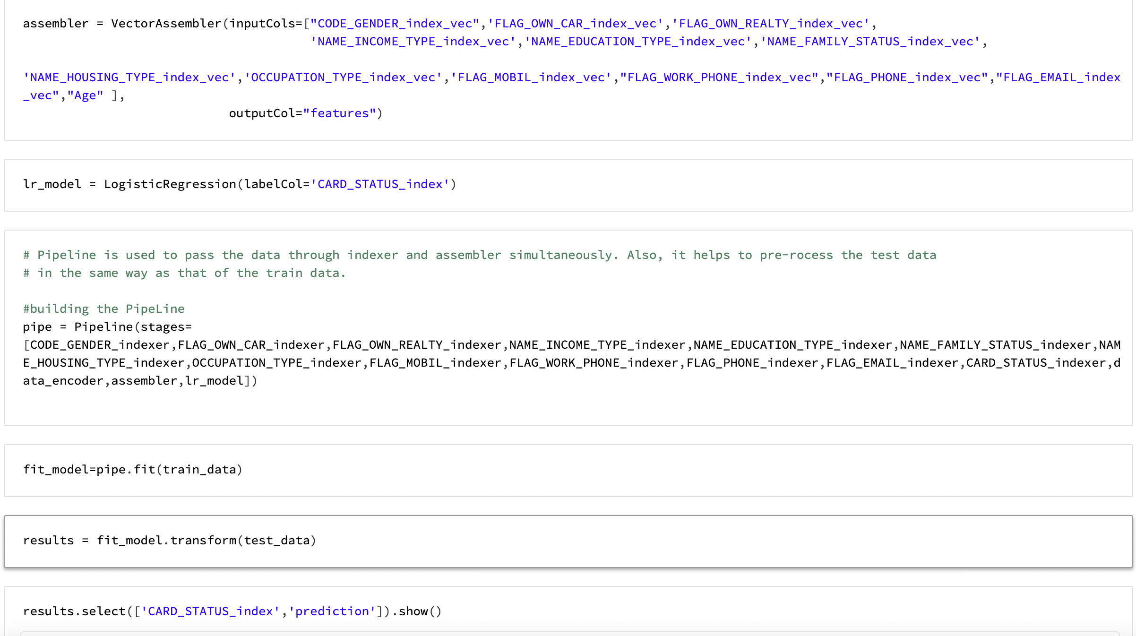
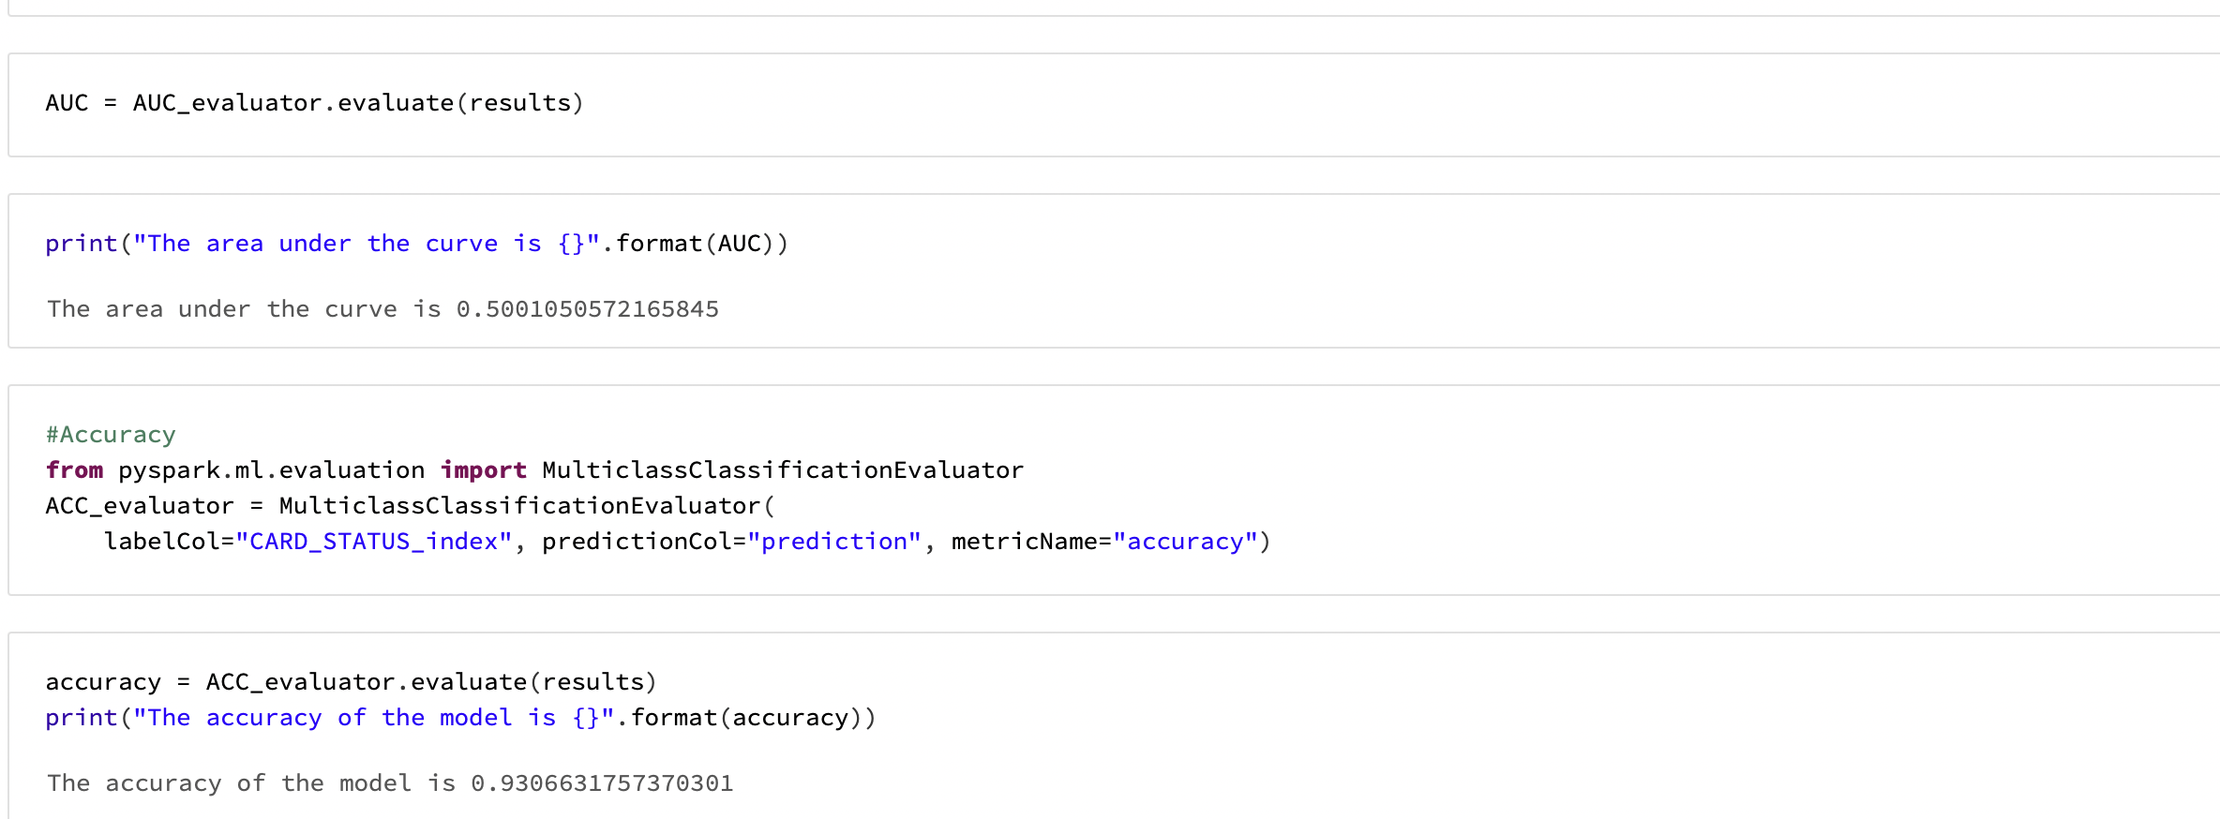
Logistic Regression Code
Screenshots below shows the vector assembler and pipe along with model accuracy achieved.

Slide 21
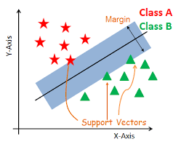
Linear Support Vector Classifier
At first approximation what SVMs do is to find a separating line(or hyperplane) between data of two classes. SVM is an algorithm that takes the data as an input and outputs a line that separates those classes if possible.
According to the SVM algorithm we find the points closest to the line from both the classes. These points are called support vectors.
Now, we compute the distance between the line and the support vectors. This distance is called the margin. Our goal is to maximize the margin. The hyperplane for which the margin is maximum is the optimal hyperplane.

Slide 22
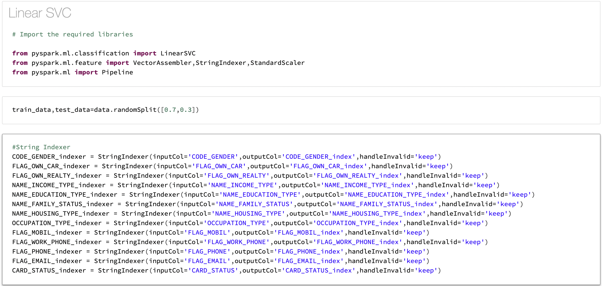
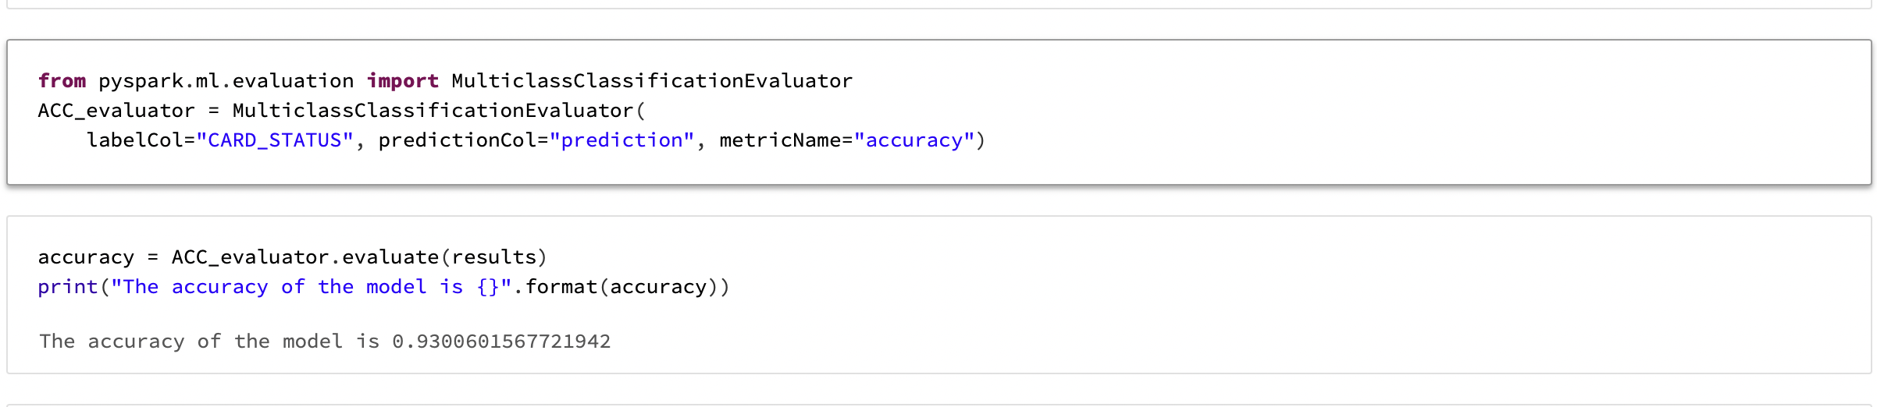
SVC Code:
With Linear SVC we got model accuracy of 93% on the test data set.

Slide 23
Project Challenges and Solutions
One major challenge we faced while working on the project is getting the labels for each row, we had to refer to various online resources regarding how the credit score works, how these scores get affected, and how does banks processes credit card request.
Other challenge was processing the data, we had significant amount of missing data in some columns.
Feature selection also took significant amount of time, as we had to perform trial and error on including and excluding various features to get the best model.

Slide 24
Business Conclusion
Firstly, we believe from the model's performance we can stream and automate the process of credit card approval for banking sectors which could save significant amount of time.
We strongly believe that binary classifier algorithms will perform well in determining the outcome on any set of features differing from bank to bank.
For Real time implementation we believe the accuracy of 93% is not sufficient and we can still improve the model accuracy by training our model better since it can cause banks significant amount of money by approving the credit card to a wrong person. If more data is available to train the model we believe that the model will perform much better.

Slide 25
Thank you!

